Slide 1
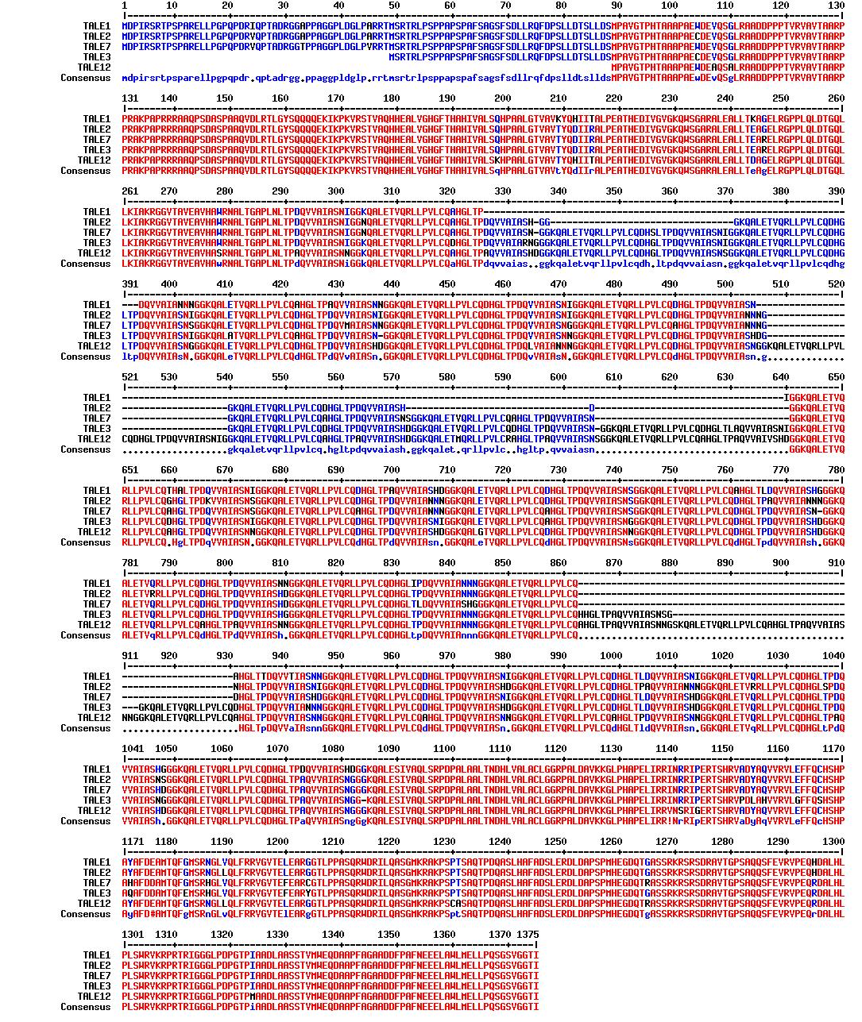
Host-pathogen interaction, Abstract ID:0152
Bioinformatic and phylogenetic analysis on TALEs revealed the closeness of Indian strain with Philippines strain of Xanthomonas oryzae pv. oryzae infecting rice
MONDAL Kalyan K.
Division of Plant Pathology, ICAR-Indian Agricultural Research Institute, Pusa Campus, New Delhi, India.
Email: mondaliari@gmail.com
INTRODUCTION
RESULTS
Xanthomonas oryzae pv. oryzae (Xoo), the causal agent of bacterial blight (BB), significantly constrain rice production globally. Race4 ,a predominant member of Indian Xoo population from North-West India, knockdown major Xa genes. Two major Type III Secretion System effectors (T3SSEs) namely Xop -Xanthomonas outer protein (21Xop effectors reported in race 4 (Mondal et al., 2014)) and different TALE-Transcription Activator Like effectors (identified different TALEs in race 4). TALEs translocate to cytosol via T3SS, mimic host gene specific transcription factors by binding to rice effector binding element (EBE) of susceptibility (S) and / or resistance (R) genes leading to enhanced expressions.
Analysis of major TALEs of Xoo race4
In the present analysis, 5 major TALEs of Indian Xoo race 4 were undertaken. These five TALEs were named as TALE1 (MN128603), TALE2 (MN128604), TALE3 (MN128605), TALE7 (MN128606) and TALE12 (MN128607) based on their prediction using AnnoTale programme The amino acid sequence alignment of the 5 TALEs showed that all are having conserved C-terminal while TALE1, TALE2 and TALE7 have conserved N-terminal also (Figure 1). TALE1 and TALE2 are highly similar sharing 89% amino acid sequence identity. TALE2 possesses 68 extra amino acids than TALE1 in the central repeat region. Further analysis revealed that TALE2 has two extra repeats than TALE1 (Figure 2). However, TALE1 and TALE2 shares different RVD sequences.
OBJECTIVE
To understand genetic relationship of race 4 with the other strains, especially from Asia and predict rice EBEs.
To analyse difference in structure of major TALEs of Xoo race 4.
MATERIALS AND METHOD
In silico identification and annotation of individual TALE(s) repertoire using AnnoTale
The sequence of major tale genes was used to estimate the amino acid sequence, their central repeats region and RVDs respectively. The genomic sequences of the 5 major tale genes were submitted to the NCBI GenBank. The annotation of TALE sequence was done using AnnoTale, a computer based software.
Sequence analysis and Phylogenetic classification of TALE(s)
The complete sequences of all tale genes of Xoo Philippines (PXO99A), Japan (MAFF311018) and Korean (KACC10331) strains obtained from database (http://www.xanthomonas.org/tools.html) were aligned using MUSCLE algorithm and the evolutionary history of the tale genes of Xoo race4 strain was inferred using neighbour-joining method with 1000 bootstrap replicates in Mega 6 software.
Figure 1. Phylogeny based on whole amino acid sequence of tale using MEGA6
CONCLUSION
The present study showed a very strong relationship of Indian Xoo strain with Philippines strain. We verified that TALE1, TALE2, TALE3 TALE7 and TALE12 have 16, 18, 22, 20 and 24 repeats, respectively. Each repeat comprises of 34 amino acids with variable amino acids at 12 and 13 position. The number of RVDs varies from 16 to 23.5.
REFERENCES
Mondal et al. 2014. PMPP 86:98-106
Grau et al. 2018, 10.1038/srep21077
Figure 2. Aligned amino acid sequence of tales using MultAlin sequence alignment
ICBB06, August 18-22, Can Tho City, Vietnam

